Slide 1
Astro 331
Payloads
SMAD Ch 9.3-9.5, 10.3

Slide 2
Lesson Objectives
Select payload frequencies using Wein’s Law and atmospheric windows
Determine whether an optical payload’s resolution is diffraction limited or pixel limited
List and describe the four common observation payload types
Describe the four dimensions for characterizing remote sensing information (spatial, spectral, radiometric, temporal)
Calculate the approximate data rate for payload data
Understand and apply the different types of design budgets used during the preliminary design of a spacecraft

Slide 3
Overview of Electromagnetic Spectrum

Slide 4
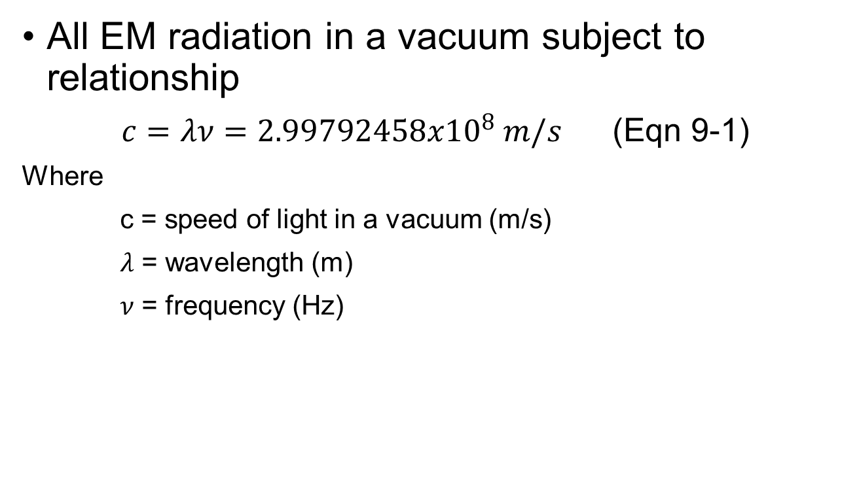
Electromagnetic Spectrum
All EM radiation in a vacuum subject to relationship
$c=λν=2.99792458x{10}^{8} m/s$ (Eqn 9-1)
Where
c = speed of light in a vacuum (m/s)
$λ$ = wavelength (m)
$ν$ = frequency (Hz)

Slide 5
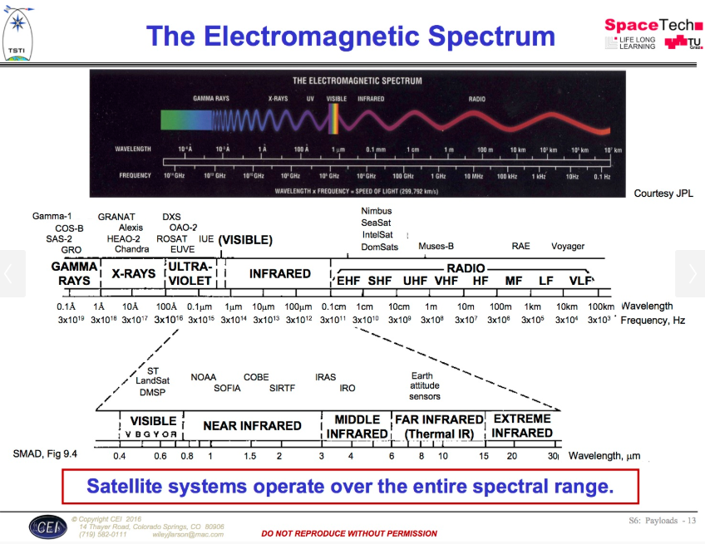
Designing Space Missions and Systems, Presentation Slide S6: Payloads - 13

Slide 6
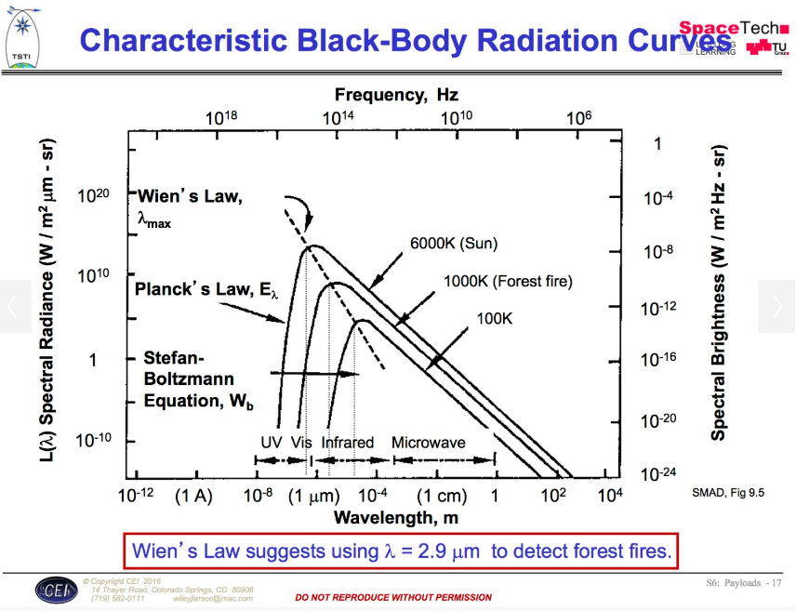
Designing Space Missions and Systems, Presentation Slide S6: Payloads - 17

Slide 7
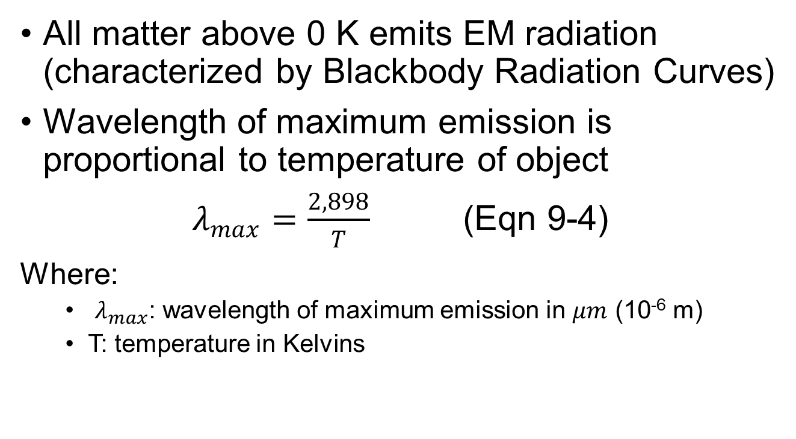
Wien’s Law
All matter above 0 K emits EM radiation (characterized by Blackbody Radiation Curves)
Wavelength of maximum emission is proportional to temperature of object
$λ_{max}=\frac{2,898}{T}$ (Eqn 9-4)
Where:
$λ_{max}$: wavelength of maximum emission in $μm$ (10⁻⁶ m)
T: temperature in Kelvins

Slide 8
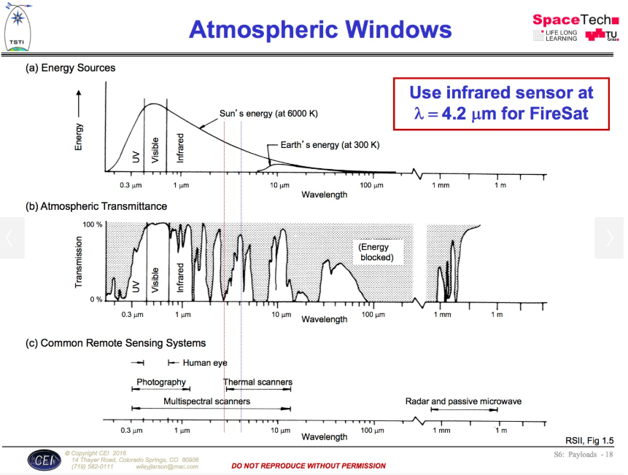
Designing Space Missions and Systems, Presentation Slide S6: Payloads - 18

Slide 9
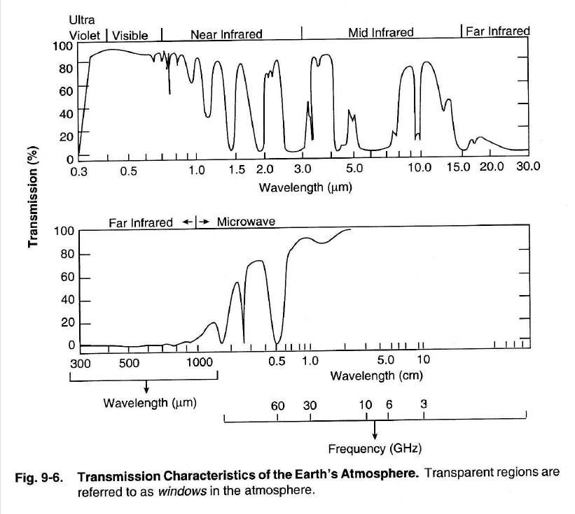

Slide 10
Telescope Design & Resolution

Slide 11
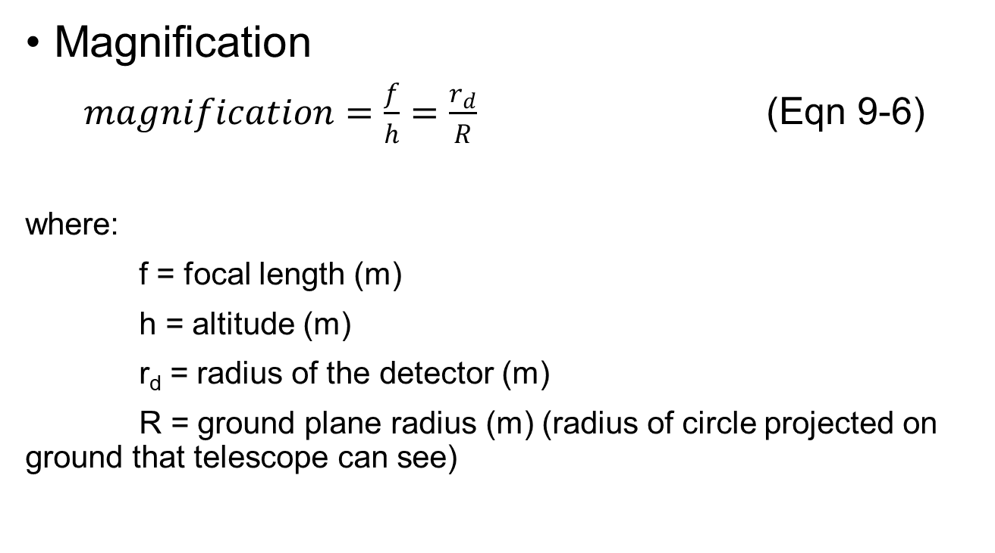
Basic Telescope Optics (1/2)
Magnification
$magnification=\frac{f}{h}=\frac{r_{d}}{R}$ (Eqn 9-6)
where:
f = focal length (m)
h = altitude (m)
r_{d} = radius of the detector (m)
R = ground plane radius (m) (radius of circle projected on ground that telescope can see)

Slide 12
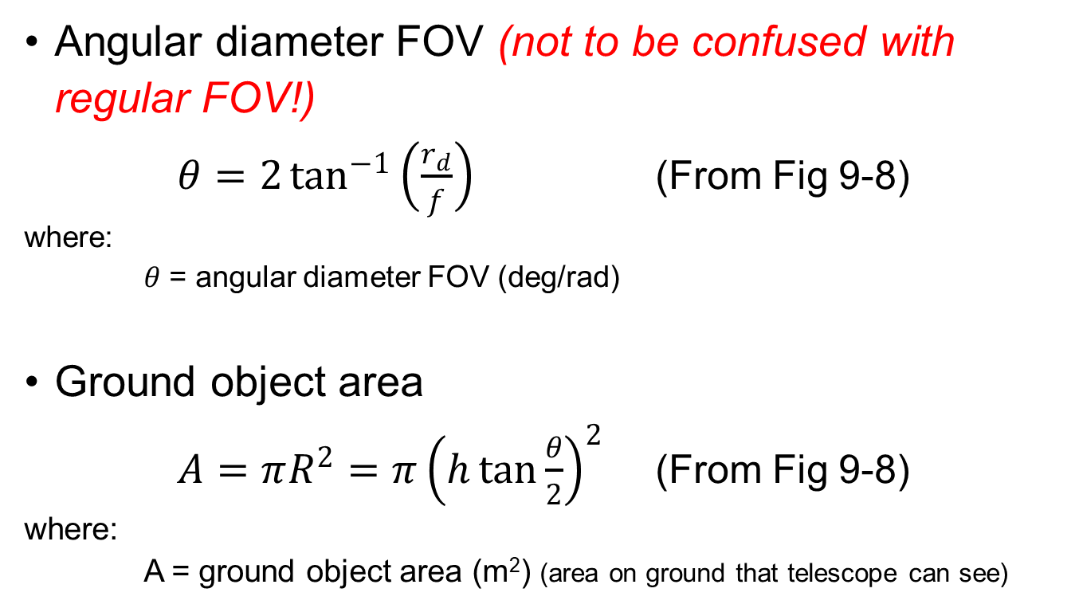
Basic Telescope Optics (2/2)
Angular diameter FOV (not to be confused with regular FOV!)
$θ=2\tan^{−1}\left(\frac{r_{d}}{f}\right)$ (From Fig 9-8)
where:
$θ$ = angular diameter FOV (deg/rad)
Ground object area
$A=πR^{2}=π{\left(h\tan{\frac{θ}{2}}\right)}^{2}$ (From Fig 9-8)
where:
A = ground object area (m²) (area on ground that telescope can see)

Slide 13
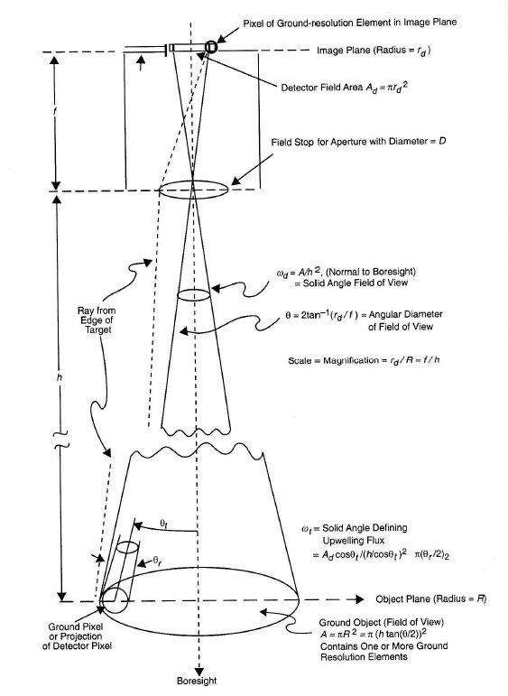
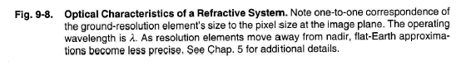

Slide 14
Resolution
Resolution: separation distance (or angle) to distinguish between two identical objects
To avoid confusion, refer to resolution as improving or better rather than increasing or decreasing
a smaller numerical value is better than a larger numerical value

Slide 15
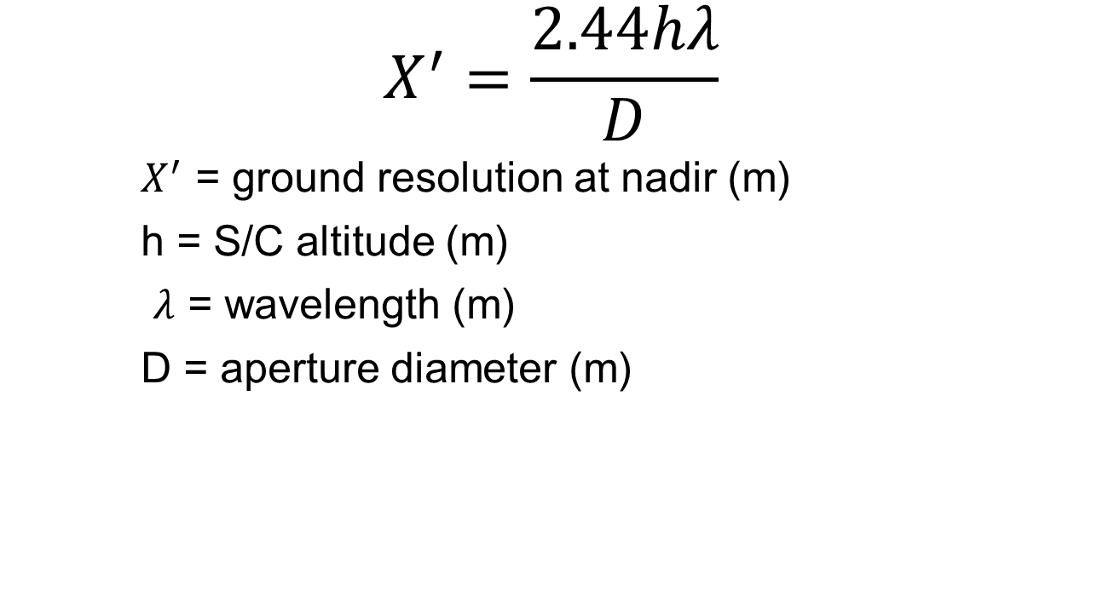
Diffraction Limited Resolution
$$X^{′}=\frac{2.44hλ}{D}$$
$X^{′}$ = ground resolution at nadir (m)
h = S/C altitude (m)
$λ$ = wavelength (m)
D = aperture diameter (m)

Slide 16
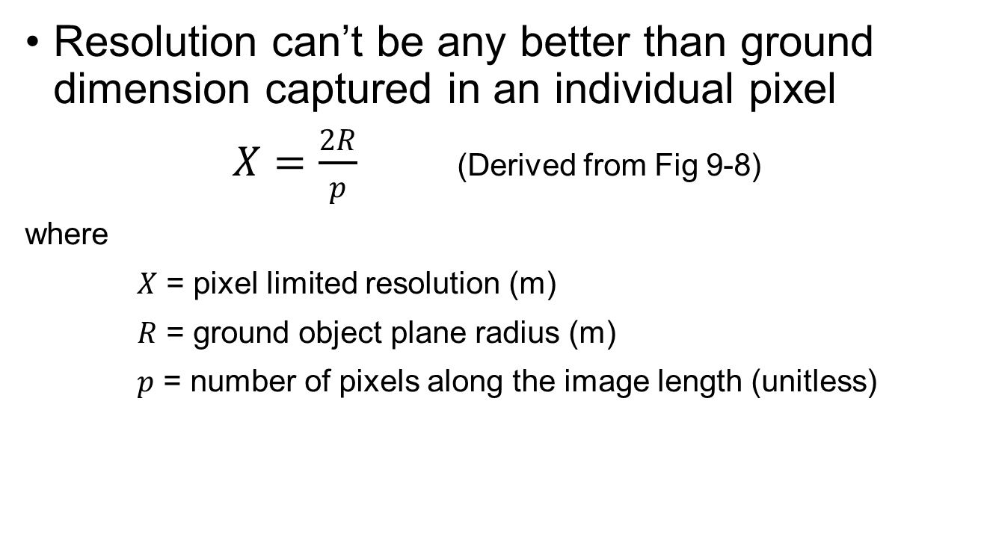
Pixel Limited Resolution
Resolution can’t be any better than ground dimension captured in an individual pixel
$X=\frac{2R}{p}$ (Derived from Fig 9-8)
where
$X$ = pixel limited resolution (m)
$R$ = ground object plane radius (m)
$p$ = number of pixels along the image length (unitless)

Slide 17
Projection of Ground Resolution Element in Image Plane
(width = d)
Image Plane
(radius = r_{d})
Focal Length, f
Lens Aperture
(diameter = D)
Altitude, h
FOV
θ_{r}
Ground Pixel or
Projection of Detector Pixel
(width = X)
Object Plane
(radius = R)
Boresight

Slide 18
Observation Payload Design

Slide 19
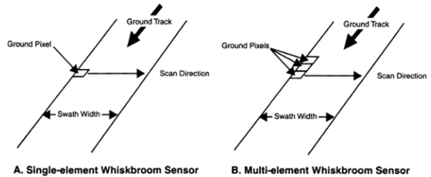
Sensor Scanning Techniques (1/3)
Fig 9-14
Whiskbroom sensors
single detector element corresponding to a single pixel
scans in crosstrack direction (often by means of a mirror)
along-track scanning accomplished by motion of S/C along groundtrack

Slide 20
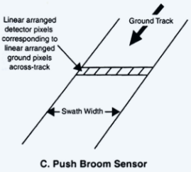
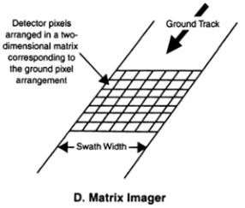
Sensor Scanning Techniques (2/3)
Fig 9-14
Pushbroom sensor
linear arrangement of sensors in crosstrack direction
entire swath width read at once
along-track scanning accomplished by motion of S/C along groundtrack
Matrix scanner (aka staring)
can capture entire image or be in segments

Slide 21
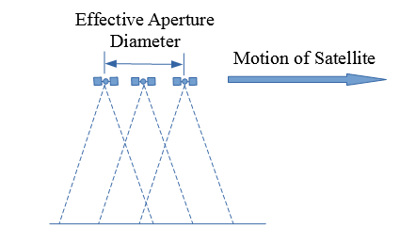
Sensor Scanning Techniques (3/3)
Synthetic aperture radar (SAR)
active sensor (s/c emits radar and collects the return)

Slide 22
Characterizing Remote Sensing Information

Slide 23
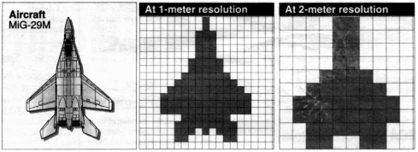
Spatial Resolution
Smallest physical features that can be discriminated
Image from Designing Space Missions and Systems, Presentation Slide 32

Slide 24
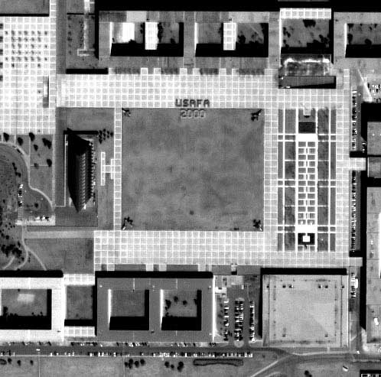

Slide 25
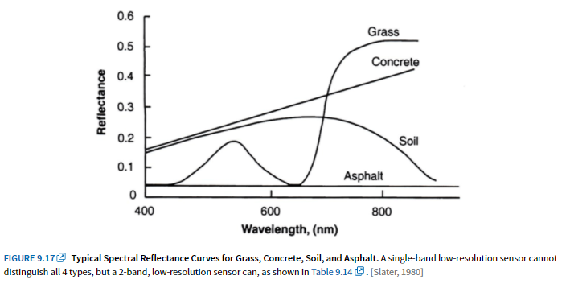
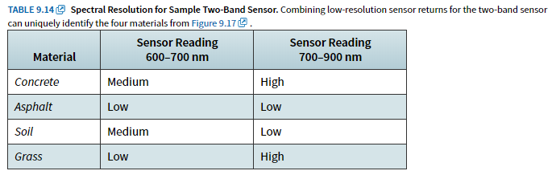
Spectral Resolution
Use spectral content of scene to identify chemical composition

Slide 26
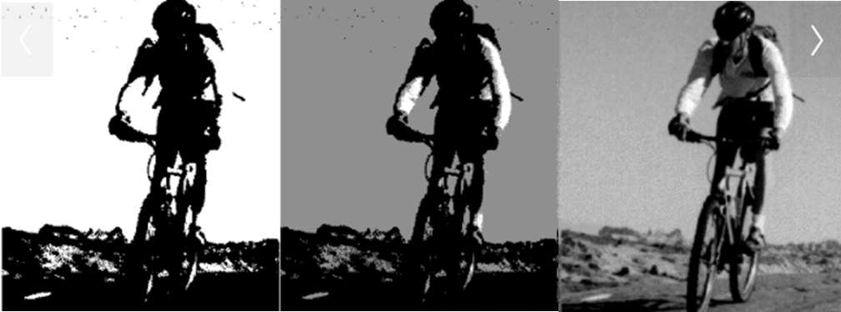
Radiance Resolution
Radiometric info (intensity): total amount of radiant energy
impacted by number of quantization levels
Image from Designing Space Missions and Systems, Presentation Slide 24

Slide 27
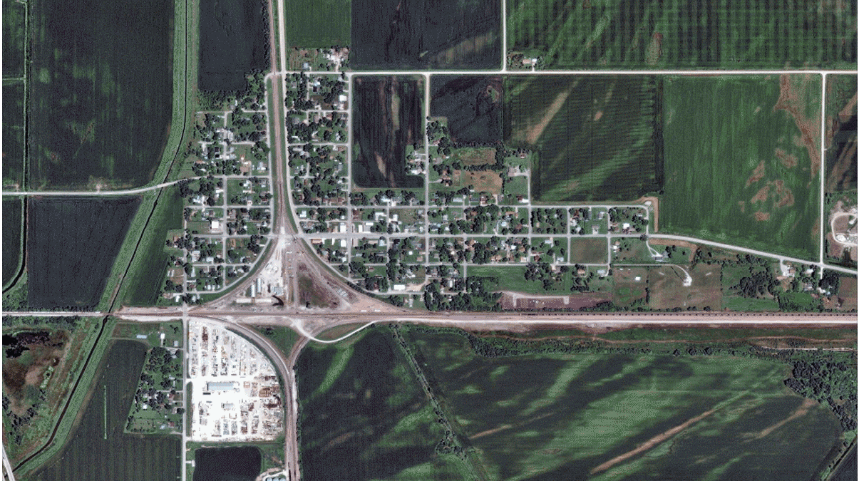
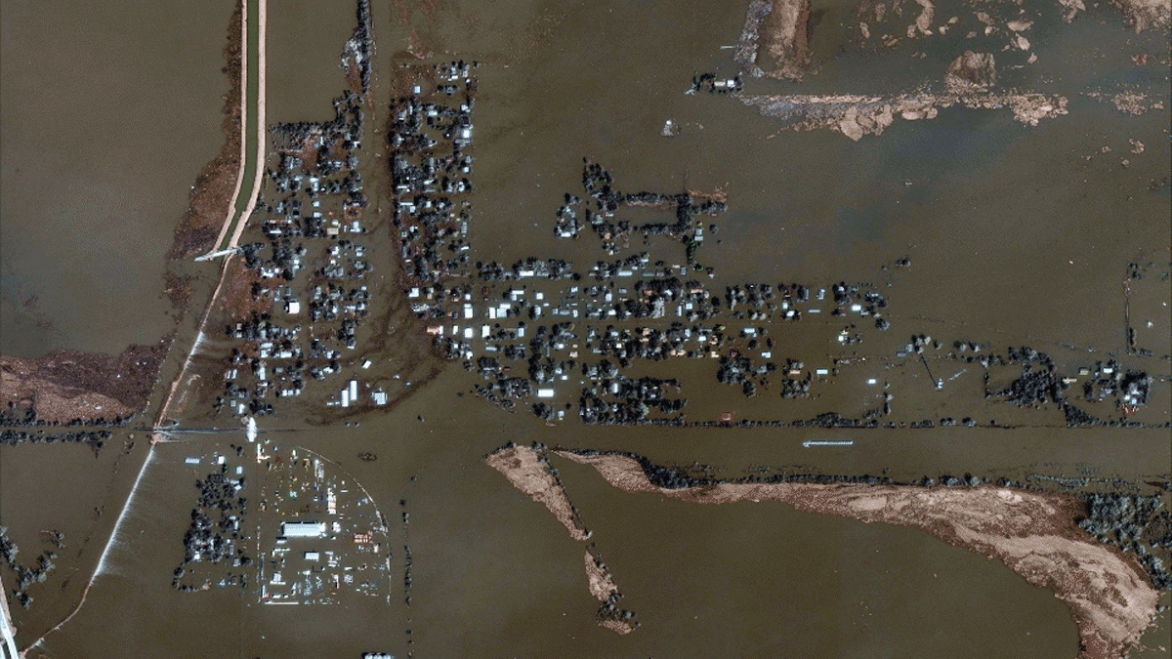
Temporal Resolution
time-changing characteristics (for comparison)
Digital Globe images of Pacific Junction, Iowa (Mar 2019)

Slide 28
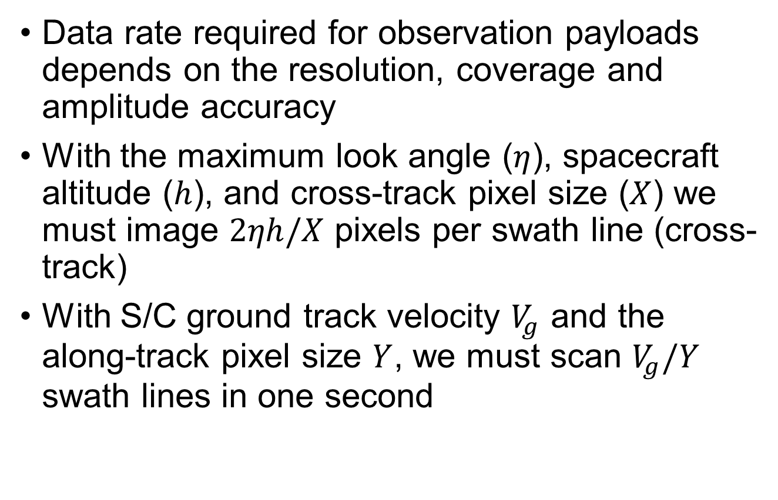
Data Rate (1/2)
Data rate required for observation payloads depends on the resolution, coverage and amplitude accuracy
With the maximum look angle ($η$), spacecraft altitude ($h$), and cross-track pixel size ($X$) we must image $2ηh/X$ pixels per swath line (cross-track)
With S/C ground track velocity $V_{g}$ and the along-track pixel size $Y$, we must scan $V_{g}/Y$ swath lines in one second

Slide 29
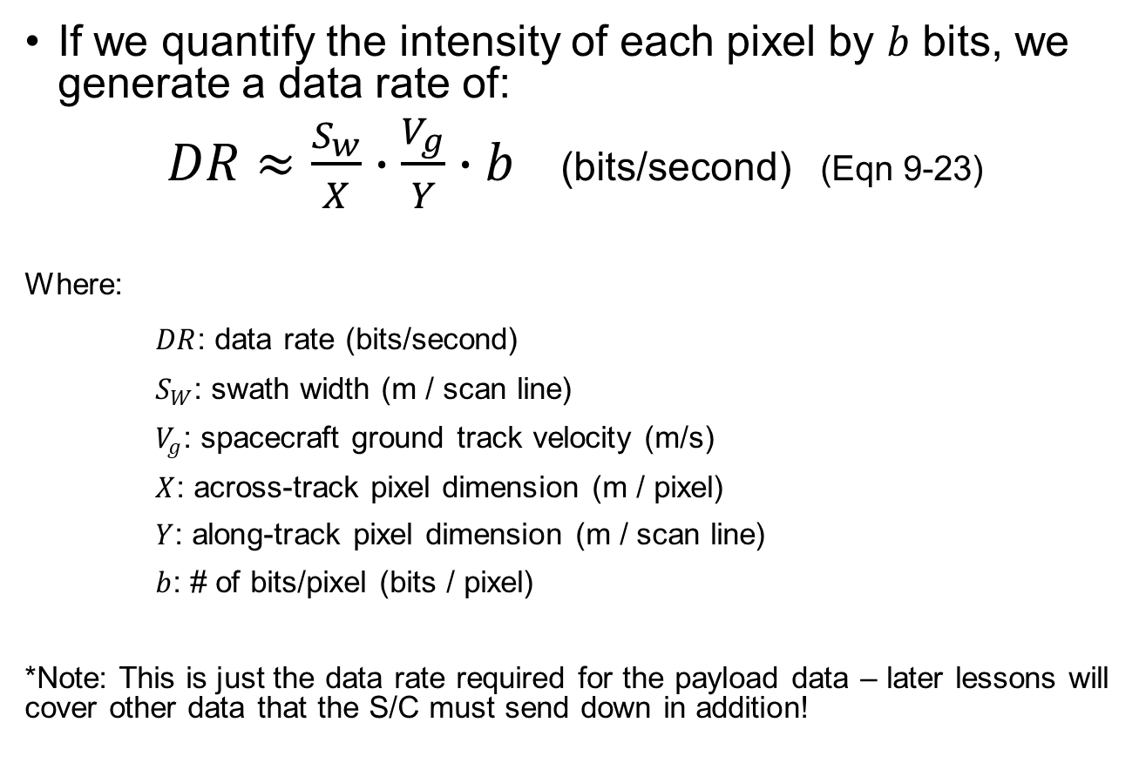
Data Rate (2/2)
If we quantify the intensity of each pixel by $b$ bits, we generate a data rate of:
$DR≈\frac{S_{w}}{X}∙\frac{V_{g}}{Y}∙b$ (bits/second) (Eqn 9-23)
Where:
$DR$: data rate (bits/second)
$S_{W}$: swath width (m / scan line)
$V_{g}$: spacecraft ground track velocity (m/s)
$X$: across-track pixel dimension (m / pixel)
$Y$: along-track pixel dimension (m / scan line)
$b$: # of bits/pixel (bits / pixel)
*Note: This is just the data rate required for the payload data – later lessons will cover other data that the S/C must send down in addition!

Slide 30
Data Rate Example (1/2)
Calculate the data rate needed for a payload with the following characteristics.
Mission characteristics:
Swath width: 50 km
Circular orbit
Altitude: 500 km
Payload characteristics:
Image detector size: 2048 x 2048 pixels
8-bit per pixel resolution

Slide 31
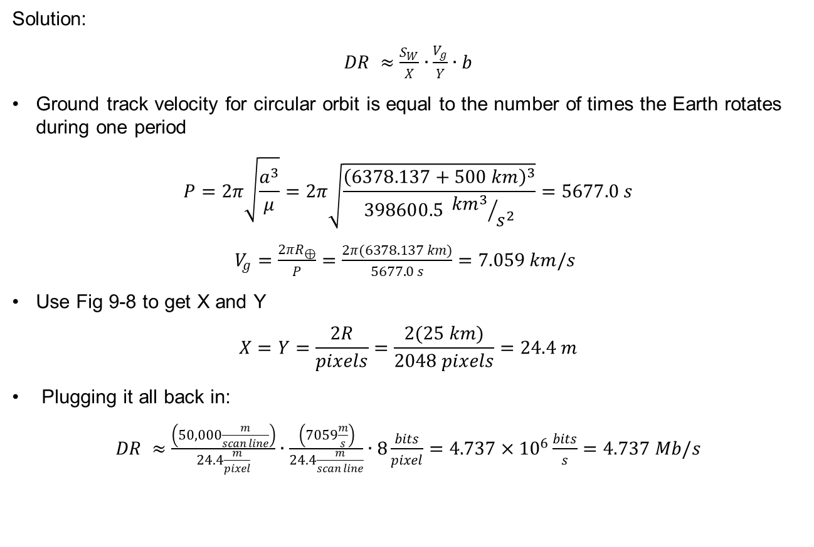
Data Rate Example (2/2)
Solution:
$DR ≈\frac{S_{W}}{X}∙\frac{V_{g}}{Y}∙b$
Ground track velocity for circular orbit is equal to the number of times the Earth rotates during one period
$$P=2π\sqrt{\frac{a^{3}}{μ}}=2π\sqrt{\frac{{\left(6378.137+500 km\right)}^{3}}{398600.5 {{km}^{3}}/{s^{2}}}}=5677.0 s$$
$V_{g}=\frac{2πR_{⊕}}{P}=\frac{2π(6378.137 km)}{5677.0 s}=7.059 km/s$
Use Fig 9-8 to get X and Y
$$X=Y=\frac{2R}{pixels}=\frac{2(25 km)}{2048 pixels}=24.4 m$$
Plugging it all back in:
$DR ≈\frac{\left(50,000\frac{m}{scan line}\right)}{24.4\frac{m}{pixel}}∙\frac{\left(7059\frac{m}{s}\right)}{24.4\frac{m}{scan line}}∙8\frac{bits}{pixel}=4.737×{10}^{6}\frac{bits}{s}=4.737 Mb/s$

